Slide 1
Generative Evaluation of RFdiffusion for Protein Backbone Design
John Wisniewski, Jakeb Milburn, Jiahao Xie
Notes:
Welcome everyone. Today, We will present our evaluation of RFdiffusion, a machine-learning framework for designing protein backbones. Our goal is to assess RFdiffusion’s ability to generate viable backbone conformations across various design paradigms, including unconditional generation, the influence of diffusion step, symmetry, and binder design.

Slide 2
Agenda
Background & Motivation
Diffusion Framework
Model Overview
Loss Components
Conditioning Paradigms
Key Experiments
Results & Discussion
Future Directions
Conclusion
References
Notes:
Let me first walk you through what we'll cover today:
We'll start with some background on protein design and the motivation behind our work
Then, we'll explain the diffusion framework that underpins RFdiffusion
We'll provide an overview of the model architecture
We'll discuss the various loss components used during training
We'll examine the different conditioning paradigms that enable controlled protein generation
Next, we'll share our key experiments and findings
We'll analyze the results and discuss both strengths and limitations
Finally, we'll touch on future directions and conclude with our main takeaways

Slide 3
Background & Motivation
Challenges in de novo protein design
Limitations of deterministic methods
Rise of generative AI in structural biology
RFdiffusion: a diffusion-based approach
Notes:
Let's start with some context. De novo protein design has been a significant challenge in structural biology for decades. Traditionally, researchers have relied on deterministic methods, which often impose limitations on the diversity and novelty of designed proteins.
In recent years, we've witnessed the rise of generative AI approaches in structural biology, changing how we tackle protein design problems. Tools like AlphaFold2 have transformed structure prediction, but the inverse problem—generating novel protein structures with desired properties—remains challenging.
This is where RFdiffusion comes in. It represents a new paradigm that leverages diffusion models, which have shown remarkable success in image generation, to now create protein backbones. Our research evaluates this approach across multiple design scenarios.

Slide 4
Diffusion Framework
Denoising Diffusion Probabilistic Models (DDPM)
Forward process: add Gaussian noise to coordinates
Reverse process: learn denoising to recover structure
Notes:
The core of RFdiffusion is based on Denoising Diffusion Probabilistic Models, or DDPMs. Let me explain how this works in the context of protein design:
In the forward process, we progressively add Gaussian noise to the protein coordinates, essentially "destroying" the structure until it becomes pure noise. This is a fixed process that doesn't involve learning.
The reverse process is where the magic happens. We train a neural network to learn how to denoise these noisy coordinates, step by step, until we recover a coherent protein structure. The model essentially learns the underlying distribution of protein structures, allowing us to sample from this distribution to generate new proteins.
This probabilistic approach enables us to sample diverse structures, unlike traditional deterministic methods that might get stuck in local minima.

Slide 5
Model Overview
RoseTTAFold backbone with Invariant Point Attention
SE(3)-transformer blocks for 3D equivariant reasoning
Conditional inputs: motifs, symmetries, binding hotspots
Notes:
RFdiffusion builds upon the RoseTTAFold architecture, which was originally designed for structure prediction. The model incorporates Invariant Point Attention, which is crucial for handling 3D geometric data.
A key component is the SE(3)-transformer blocks, which provide 3D equivariant reasoning. This means the model's predictions are invariant to rotations and translations in 3D space—an essential property when working with protein structures.
The model can take various conditional inputs, including structural motifs (when you want to preserve certain regions), symmetry constraints (for designing oligomeric proteins), and binding hotspots (for targeted binding interfaces). These conditional inputs guide the generative process toward desired outcomes.

Slide 6
Loss Components
Coordinate loss: MSE on Cα positions
Frame loss: rotation error between predicted and true frames
Torsion loss: preserving backbone ψ/φ angles
Symmetry loss: enforcing oligomeric constraints
Notes:
During training, the model optimizes several loss components:
The primary one is coordinate loss, which is the mean squared error between predicted and true Cα positions. This ensures the backbone geometry is correct.
We also have frame loss, which measures the rotation error between predicted and true frames. This helps maintain proper orientation throughout the protein.
Torsion loss preserves the backbone ψ and φ angles, which are critical for protein folding and stability.
For oligomeric designs, we include symmetry loss to enforce the desired symmetry constraints, ensuring subunits relate to each other correctly.
Together, these losses ensure that the generated structures adhere to physical and biochemical principles that govern protein folding.

Slide 7
Conditioning Paradigms
Motif scaffolding: preserve user-defined structural motifs
Symmetry constraints: design cyclic or dihedral oligomers
Hotspot binding: guide backbone to target binding sites
Notes:
RFdiffusion supports several conditioning paradigms that enable controlled generation:
Motif scaffolding allows us to preserve user-defined structural motifs. For example, if you have a functional binding site you want to maintain, you can condition the generation process to build around it.
Symmetry constraints enable the design of cyclic or dihedral oligomers. This is particularly important for designing protein assemblies with specific symmetries, like viral capsids or ion channels.
Hotspot binding guides the backbone to target specific binding sites. This is valuable when designing proteins that need to interact with specific partners.
These conditioning mechanisms make RFdiffusion highly versatile for various protein engineering applications.

Slide 8
Unconditional Generation
Tested lengths: 100, 200, 300 residues
Metrics: pLDDT confidence & RMSD to native structures
Results: high-confidence, diverse fold sampling
Notes:
Our first set of experiments focused on unconditional generation—creating proteins without any specific constraints.
We tested generation at three different lengths: 100, 200, and 300 residues, to assess the model's capability across different protein sizes.
To evaluate quality, we used two primary metrics:
pLDDT (predicted local distance difference test) confidence scores, which measure the reliability of the structure
RMSD (root mean square deviation) to native structures, which quantifies structural similarity
The results showed that RFdiffusion can generate high-confidence, diverse protein folds across all tested lengths. This demonstrates the model's ability to capture the complex distribution of protein structures.

Slide 9
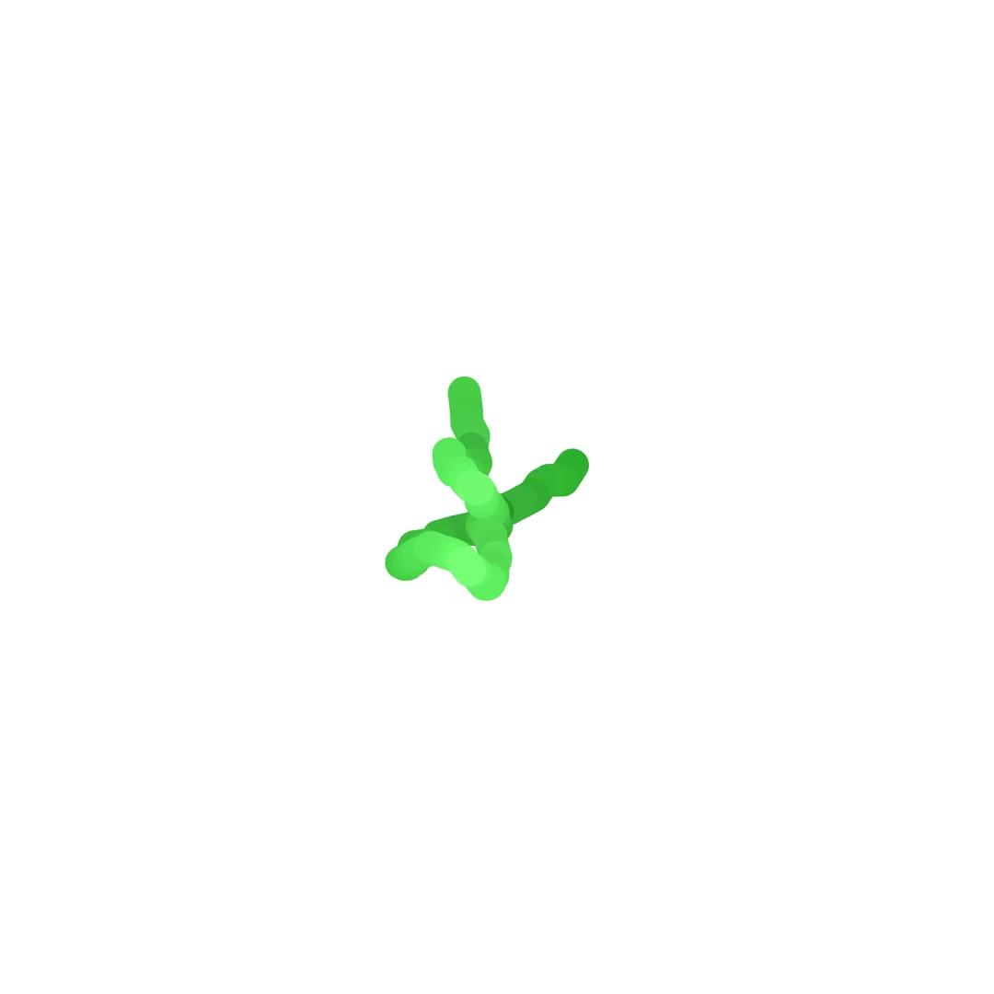

Slide 10
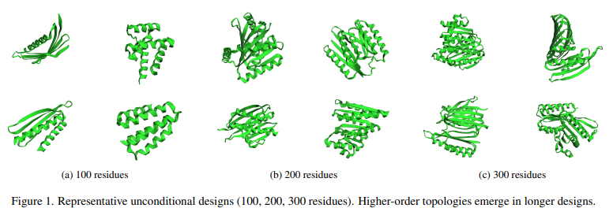
Unconditional Generation
Notes:
Here we can see representative examples of the unconditionally generated structures. Notice the diversity of folds and topologies that emerge naturally from the generative process.
As you can see, the 100-residue designs tend to form simpler structures, while the longer designs—200 and 300 residues—exhibit more complex topologies with multiple domains and more intricate folds. This matches our understanding of natural protein architecture, where longer proteins tend to have more complex geometric structures.

Slide 11
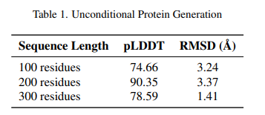
Unconditional Generation
Notes:
This table summarizes our quantitative results for unconditional generation.
These results suggest that RFdiffusion performs particularly well on medium to large proteins, with the 200-residue designs showing the highest confidence scores. The improvement in RMSD for 300-residue designs indicates that longer proteins might benefit from more defined structural constraints as they fold.

Slide 12
Step Sensitivity Analysis
Evaluated reverse diffusion steps: 25, 50, 100, 200
Trade-off: fewer steps accelerate generation but may degrade quality
Optimal performance observed around 100 steps
Notes:
Next, we conducted a sensitivity analysis to understand how the number of diffusion steps affects generation quality.
We evaluated four different step counts: 25, 50, 100, and 200 steps in the reverse diffusion process.
There's an important trade-off here: fewer steps accelerate the generation process but may compromise quality, while more steps might yield more accurate structures but at higher computational cost.
Our results indicate that optimal performance occurs around 100 steps, balancing efficiency and quality. This finding has practical implications for deploying RFdiffusion in real-world applications where generation speed matters.

Slide 13
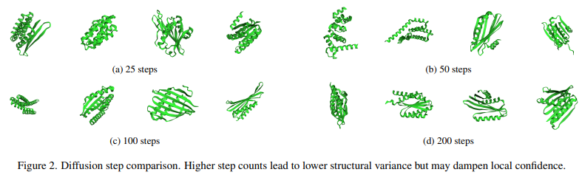
Step Sensitivity Analysis
Notes:
This slide shows examples of structures generated with different step counts.
You can observe that with just 25 steps, we already get reasonably formed structures, but they may lack some of the refined details.
At 50 steps, more structural features emerge, and by 100 steps, we see well-defined secondary structure elements and tertiary arrangements.
Interestingly, at 200 steps, while the structures appear more refined, we noted that the local confidence might be dampened in some cases. This suggests a balance is needed—more steps don't always translate to better results.

Slide 14
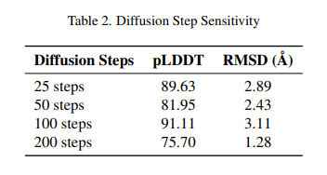
Step Sensitivity Analysis
Notes:
The quantitative results confirm our observations:
With 25 steps, we achieved a pLDDT of 89.63 and an RMSD of 2.89 Å. With 50 steps, the pLDDT decreased slightly to 81.95, with an improved RMSD of 2.43 Å. At 100 steps, we saw the highest pLDDT of 91.11, though with a slightly higher RMSD of 3.11 Å. Finally, at 200 steps, the pLDDT decreased to 75.70, but we observed the best RMSD of 1.28 Å.
These results suggest an interesting pattern: while more steps can lead to lower structural variance (better RMSD), they might not always result in higher confidence scores. This highlights the importance of carefully selecting the diffusion steps based on the specific application requirements.

Slide 15
Symmetric Oligomer Results
Designed C4 and D2 symmetric oligomers
Metrics: symmetry RMSD & interface contact accuracy
Generated assemblies closely match target symmetry
Notes:
Moving on to symmetric designs, we focused on creating C4 and D2 symmetric oligomers.
For evaluation, we used symmetry RMSD, which measures how well the generated structures adhere to the desired symmetry, and interface contact accuracy, which assesses the quality of subunit interactions.
The results demonstrated that RFdiffusion can successfully generate oligomeric structures that closely match the target symmetry. This capability is particularly valuable for designing protein assemblies with specific functional properties.

Slide 16
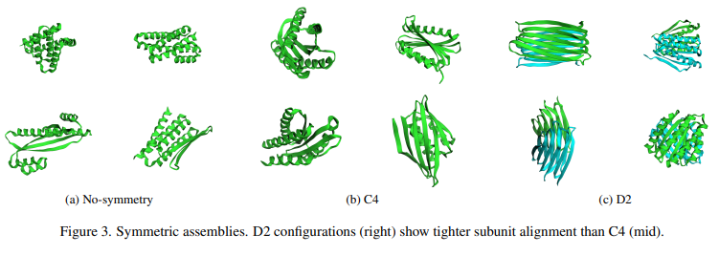
Symmetric Oligomer Results
Notes:
This slide shows examples of our oligomeric designs.
On the left, we have non-symmetric structures for comparison. In the middle, you can see C4 symmetric designs, which exhibit four-fold rotational symmetry around a central axis. On the right are D2 symmetric designs, which have two perpendicular two-fold symmetry axes.
Notice that the D2 configurations show tighter subunit alignment than the C4 designs. This is likely because D2 symmetry provides more constraints on the relative orientation of subunits, leading to more defined interfaces.

Slide 17
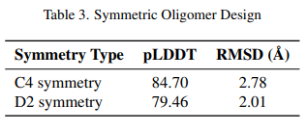
Symmetric Oligomer Results
Notes:
Looking at the quantitative results:
For C4 symmetry, we achieved a pLDDT of 84.70 and an RMSD of 2.78 Å. For D2 symmetry, the pLDDT was slightly lower at 79.46, but with a better RMSD of 2.01 Å.
This aligns with our visual observations: D2 designs had tighter structural constraints, resulting in lower RMSD values, even though the confidence scores were slightly lower than for C4 designs.

Slide 18
Binder Design Task
Unguided vs. hotspot-guided binder generation
Evaluated shape complementarity and binding energy
Hotspot conditioning improves interface metrics
Notes:
For our final experiment, we evaluated RFdiffusion's ability to design protein binders. We compared unguided binder generation versus hotspot-guided approaches.
We assessed these designs using shape complementarity, which measures how well the interfaces fit together, and binding energy, which quantifies the strength of the interaction.
Our results showed that hotspot conditioning significantly improves interface metrics, leading to more specific and energetically favorable binding interactions.

Slide 19
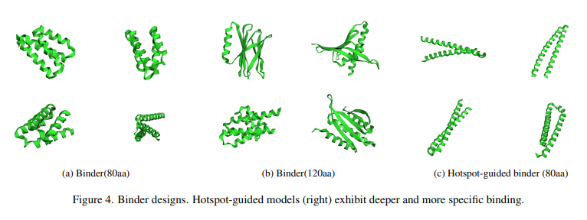
Binder Design Task
Notes:
Here we see examples of our binder designs:
On the left are 80-residue binders generated without guidance. In the middle are larger 120-residue unguided binders. And on the right are 80-residue hotspot-guided binders.
Notice how the hotspot-guided models on the right exhibit more defined helical structures specifically positioned for binding. They show deeper and more specific binding interfaces compared to the unguided approaches.

Slide 20
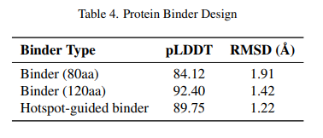
Binder Design Task
Notes:
The quantitative results confirm the visual observations:
For 80-residue unguided binders, we observed a pLDDT of 84.12 and an RMSD of 1.91 Å. For 120-residue unguided binders, the pLDDT improved to 92.40 with a better RMSD of 1.42 Å. Most importantly, for hotspot-guided binders, we achieved a pLDDT of 89.75 and the best RMSD of 1.22 Å.
These results highlight the value of hotspot guidance in binder design, producing structures that are both confident and accurately positioned for binding.

Slide 21
Discussion: Strengths
Versatile across multiple design paradigms
Probabilistic sampling yields structural diversity
Equivariance ensures geometric accuracy
Notes:
Let's discuss the strengths of RFdiffusion based on our evaluation:
The model is remarkably versatile across multiple design paradigms, from unconditional generation to symmetric oligomers and targeted binders.
Its probabilistic sampling approach yields structural diversity that deterministic methods struggle to achieve. This is crucial for exploring novel protein folds and functions.
The equivariance properties ensure geometric accuracy in 3D space, maintaining proper structural relationships regardless of orientation.
Together, these strengths position RFdiffusion as a powerful tool in the protein design toolbox, complementing existing approaches with its unique generative capabilities.

Slide 22
Discussion: Limitations
No integrated sequence design module
Limited direct diversity control
Requires post-processing for atomic refinement
Notes:
Despite its strengths, RFdiffusion has several limitations:
The most significant is the lack of an integrated sequence design module. RFdiffusion generates backbones only, requiring separate tools for sequence design. This two-step process may not capture the intricate relationships between sequence and structure.
Related to this, there's limited direct control over diversity. While the model generates diverse structures, we can't easily steer this diversity in specific directions without additional tools.
Finally, the generated backbones require post-processing for atomic refinement. The model outputs Cα traces, which need to be converted to full-atom models and refined before experimental validation.
Addressing these limitations represents important areas for future work.

Slide 23
Future Directions
Combine structure and sequence diffusion for end-to-end design
Integrate energy-based refinement during sampling
Develop metrics for functional constraint conditioning
Scale to larger complexes and novel topologies
Notes:
Looking ahead, we see several exciting directions for advancing this research:
A primary goal is to combine structure and sequence diffusion for end-to-end design. This would enable simultaneous optimization of backbone and sequence, potentially leading to more accurate and functional designs.
Integrating energy-based refinement during the sampling process could improve the physical realism of generated structures without requiring separate refinement steps.
Developing metrics for functional constraint conditioning would allow us to design proteins with specific functional properties, not just structural features.
Finally, scaling to larger complexes and novel topologies could open new frontiers in protein engineering, enabling the design of complex assemblies with unprecedented functions.

Slide 24
Conclusion
RFdiffusion effectively generates diverse protein backbones
Supports motif, symmetry, and binder design
Next step: integrated sequence-structure generative models
Notes:
To conclude, our evaluation demonstrates that RFdiffusion effectively generates diverse protein backbones across various design scenarios.
The model successfully supports motif scaffolding, symmetry constraints, and binder design—key capabilities for practical protein engineering applications.
The next frontier lies in developing integrated sequence-structure generative models that can seamlessly design both the backbone and sequence together.
RFdiffusion represents an important step forward in protein design methodology, leveraging the power of diffusion models to expand the toolkit available to protein engineers and structural biologists.

Slide 25
References
Watson et al., Nature (2023) – RFdiffusion: Diffusion-based protein backbone generation
Ho et al., NeurIPS (2020) – Denoising Diffusion Probabilistic Models
Baek et al., Science (2021) – RoseTTAFold: Accurate structure prediction
Jumper et al., Nature (2021) – AlphaFold2: Deep learning for protein structure
Notes:
These key publications provide foundational concepts: RFdiffusion methodology, diffusion modeling theory, and state-of-the-art structure prediction frameworks.

Slide 26
Thank You!
Q & A

